Slide 1
Weekly Project Update
Laurent Bialylew
Daniil Karbukov
Xie Wenhao

Slide 2
Work done this week
01
02
03
04
Created UMLs
Created a README file
Expanded existing UMLs with new functions
Added a README file to our github repository
Setup Crow
Added new functions
Set up crow framework so that we can implement our code into the web app
Created the a function to register a patient and a function to book an appointment

Slide 3
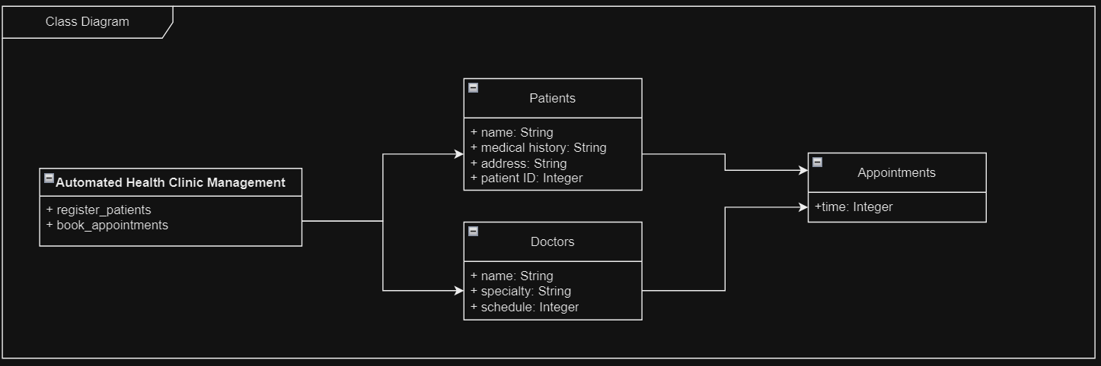
Class UML

Slide 4
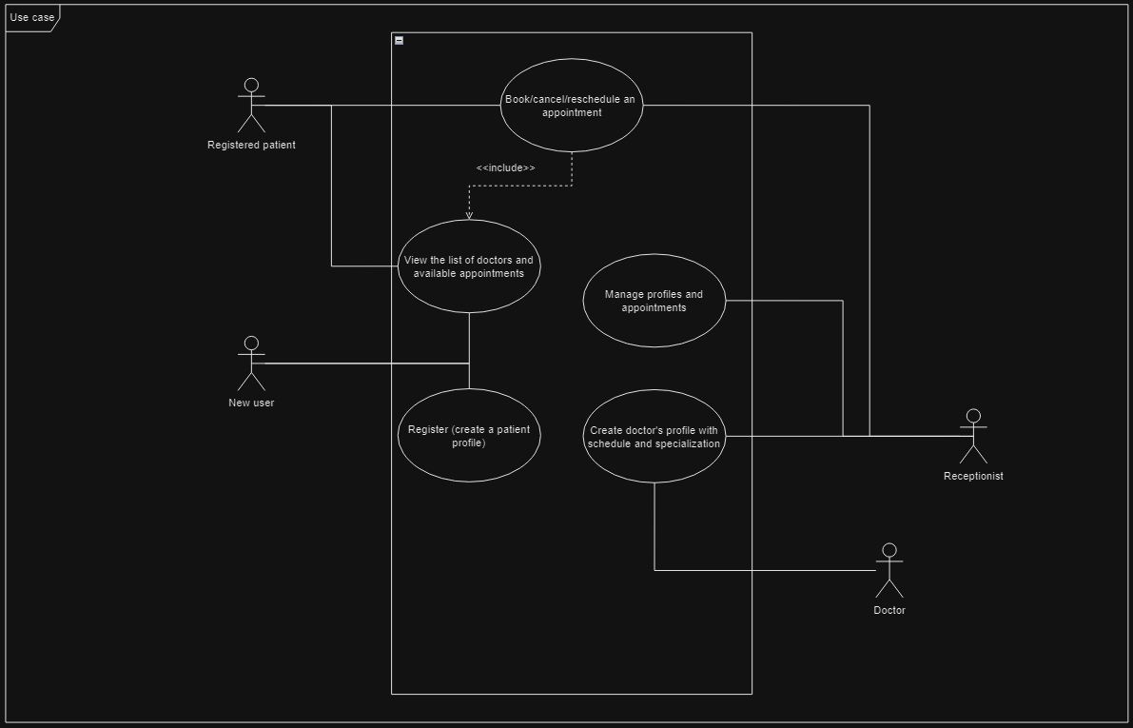
Use case UML

Slide 5
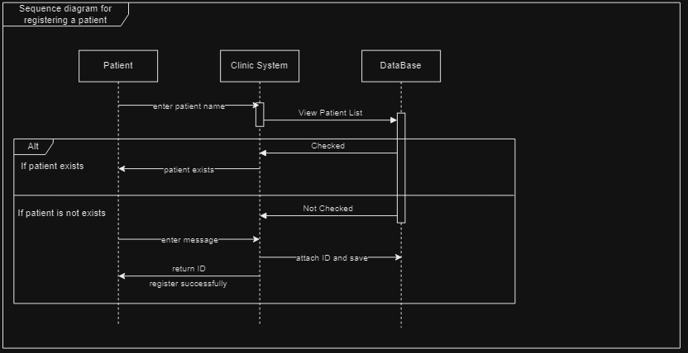
Sequence UML for registering a patient

Slide 6
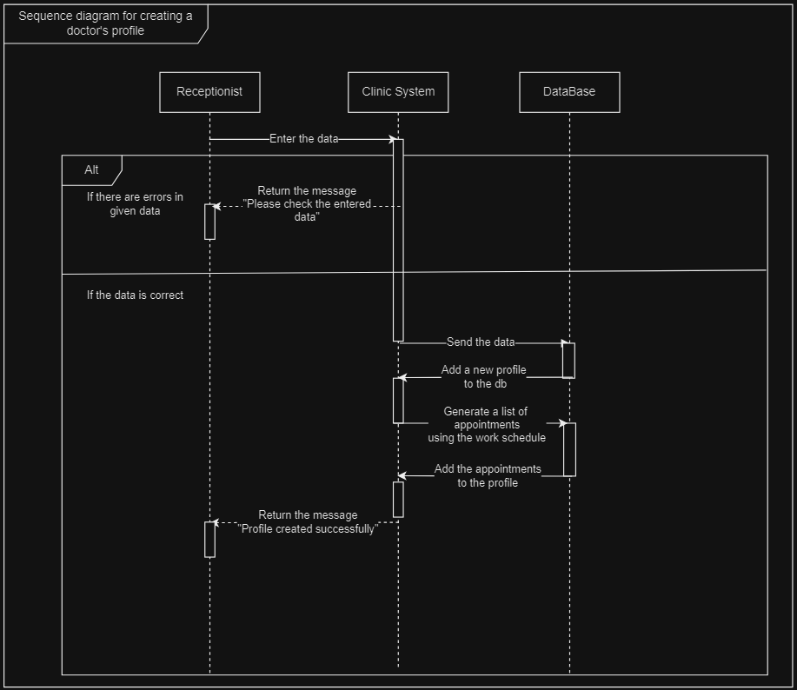
Sequence UML for creating a doctor's profile

Slide 7
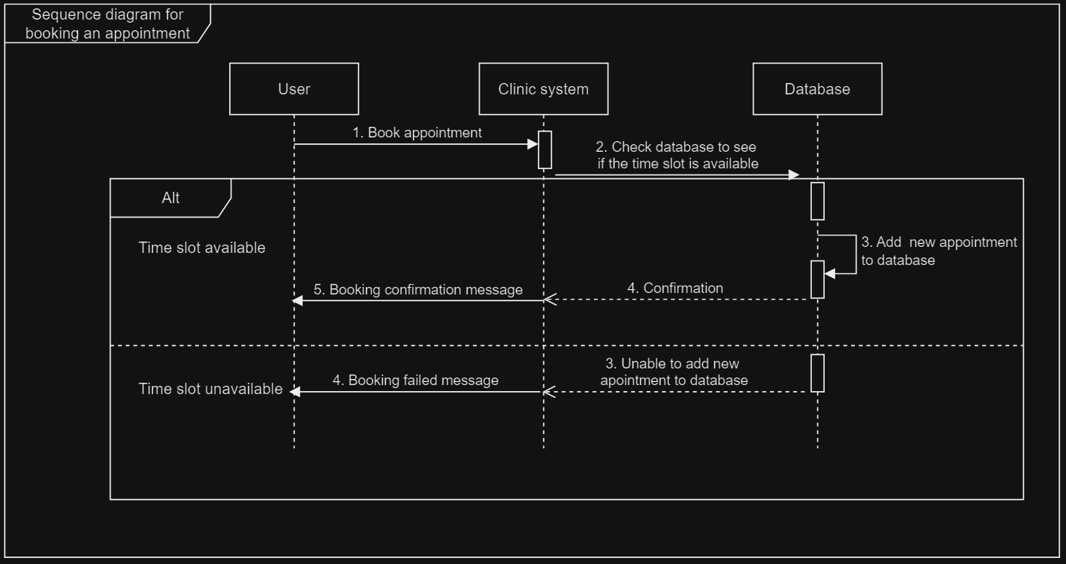
Sequence UML for booking an appointment

Slide 8
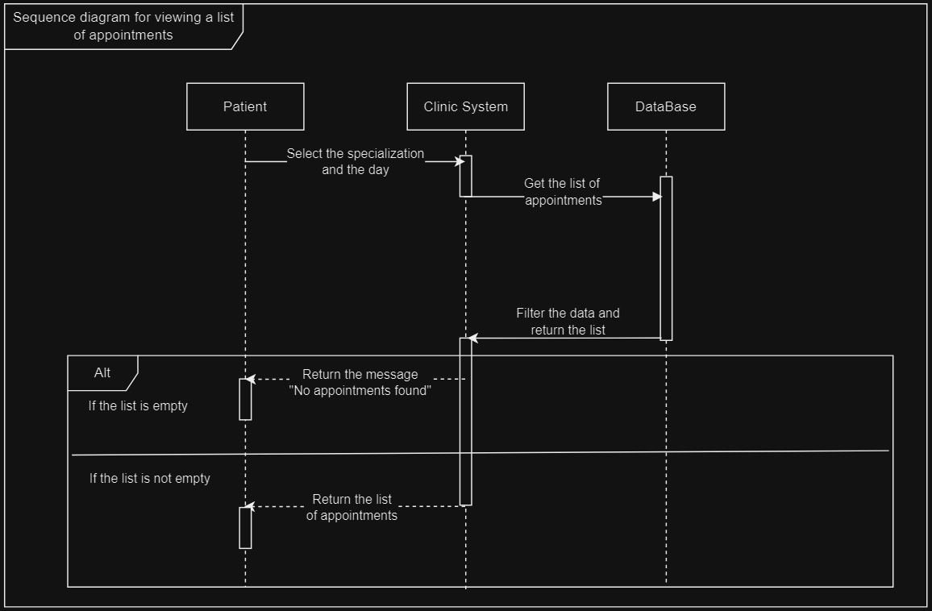
Sequence UML for viewing appointment list

Slide 9
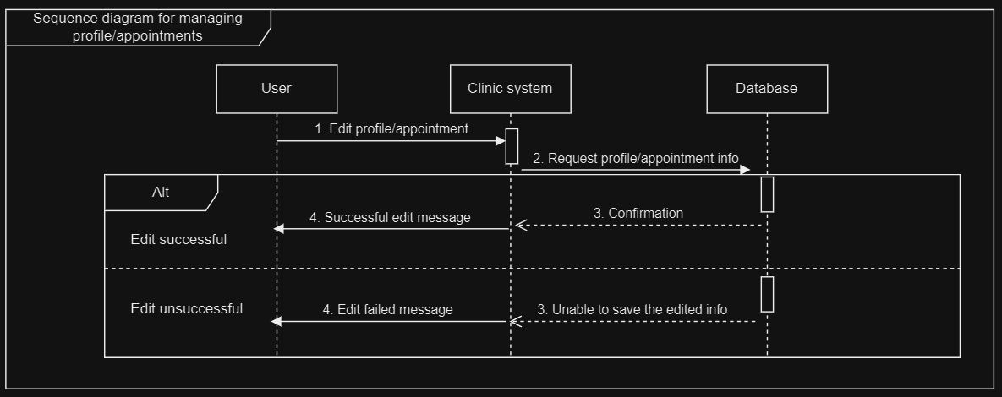
Sequence UML for managing appointments and profiles

